Slide 1
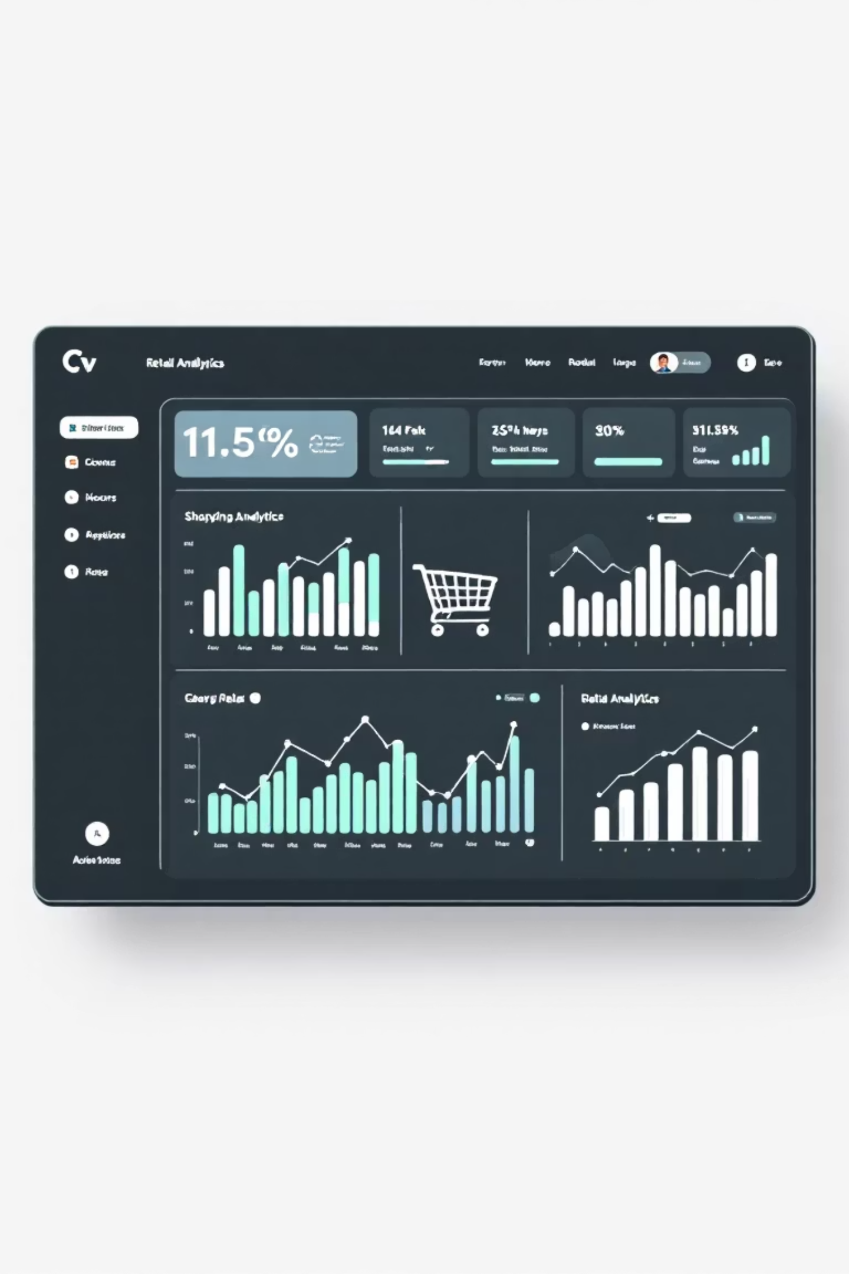
Customer Shopping Behavior Analysis
Uncovering insights from 3,900 purchases to guide strategic business decisions
By: S.Yoga

Slide 2

Dataset Overview
3,900
18
50
Total Purchases
Data Points
Locations
Transactions analyzed
Features per transaction
Geographic coverage
$59.76
Avg Purchase
Per transaction
Comprehensive data spanning demographics, purchase details, and shopping behavior patterns

Slide 3
Data Preparation & Cleaning
01
02
Data Loading
Missing Data Handling
Imported dataset using pandas, explored structure with df.info() and summary statistics
Imputed 37 missing Review Rating values using median rating per product category
03
04
Feature Engineering
Database Integration
Created age_group bins and purchase_frequency_days columns for deeper analysis
Connected to MYSQL and loaded cleaned data for SQL analysis

Slide 4
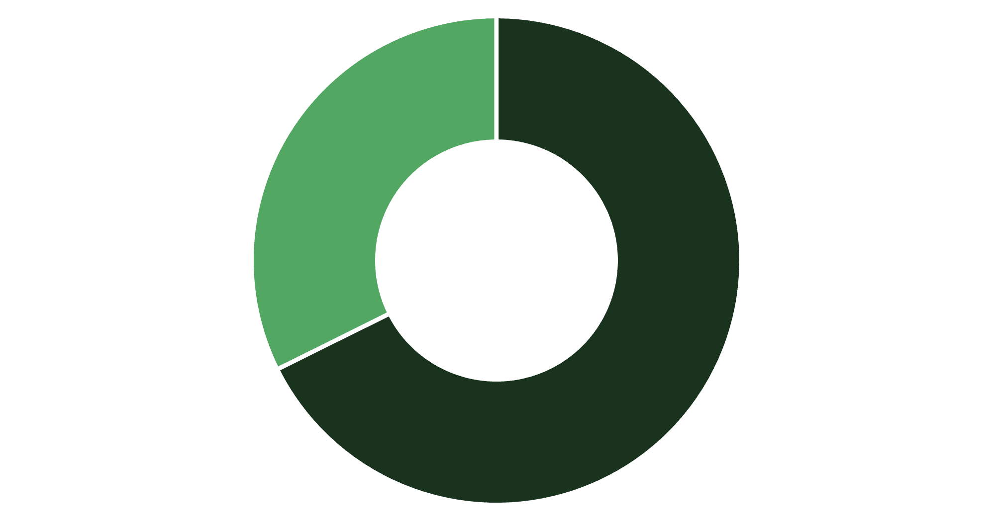
Revenue Insights by Gender
Key Finding
Male customers generate 68% of total revenue, significantly outpacing female customers
Strategic opportunity to boost female customer engagement and spending
Male
Female

Slide 5

Top-Rated Products
Gloves
Sandals
Boots
3.86 rating
3.84 rating
3.82 rating
Hat
Skirt
3.80 rating
3.78 rating
Highlight these top performers in marketing campaigns to drive sales

Slide 6


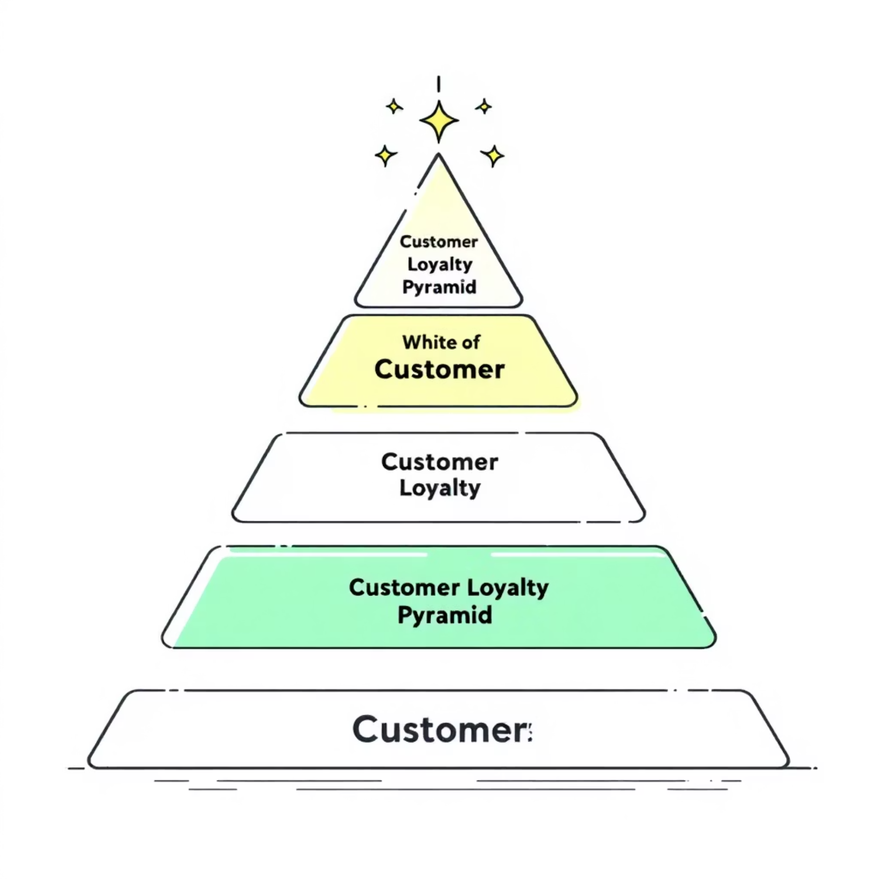
Customer Segmentation Analysis
New
1
83
2
Returning
701
3
Loyal
3,116
Segment Distribution
80% Loyal customers - Strong retention foundation
18% Returning - Growth opportunity
2% New - Acquisition focus needed

Slide 7



Subscription Status Impact
27%
73%
Subscribers
Non-Subscribers
1,053 customers
2,847 customers
Revenue Comparison
Subscribers: $62,645 total revenue
Non-subscribers: $170,436 total revenue
Average spend nearly identical: $59.49 vs $59.87
Opportunity: 958 repeat buyers (>5 purchases) without subscriptions represent untapped subscription potential

Slide 8
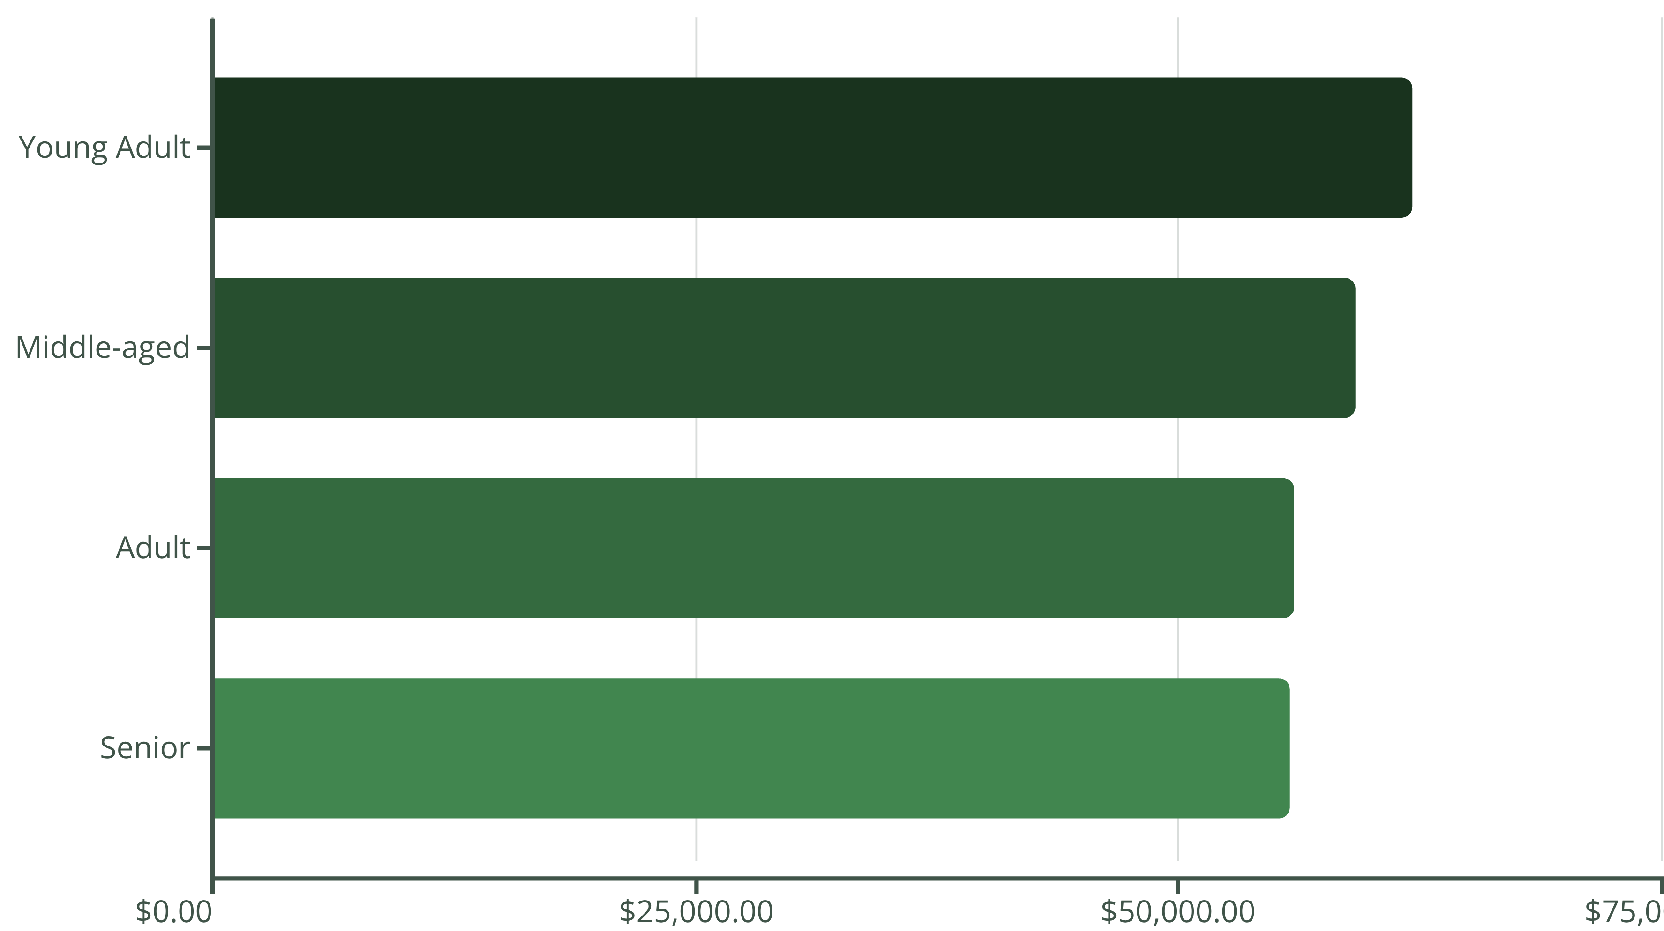
Revenue by Age Group
Young Adults lead revenue generation, followed closely by Middle-aged customers. Remarkably balanced distribution across all age segments.

Slide 9

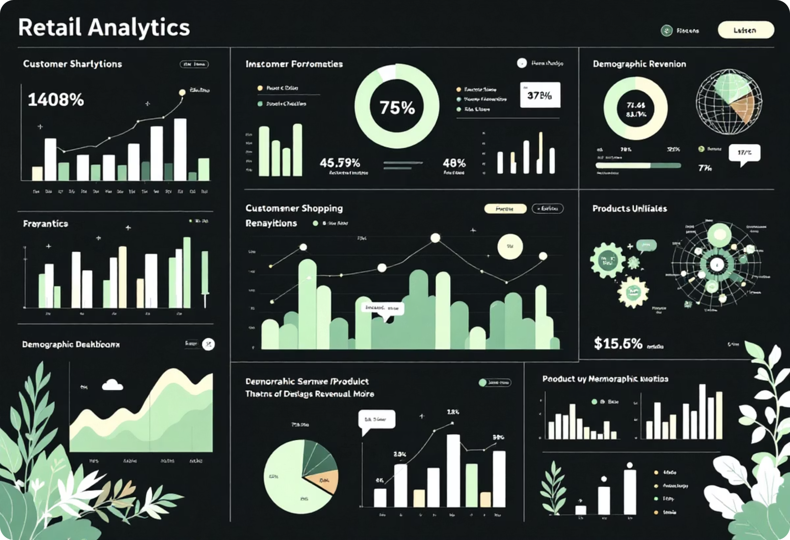
Interactive Dashboard
Real-Time Metrics
Track customer count, average purchase, and review ratings
Category Performance
Compare revenue and sales across Clothing, Accessories, Footwear, Outerwear
Demographic Insights
Analyze age groups, subscription status, and shipping preferences

Slide 10
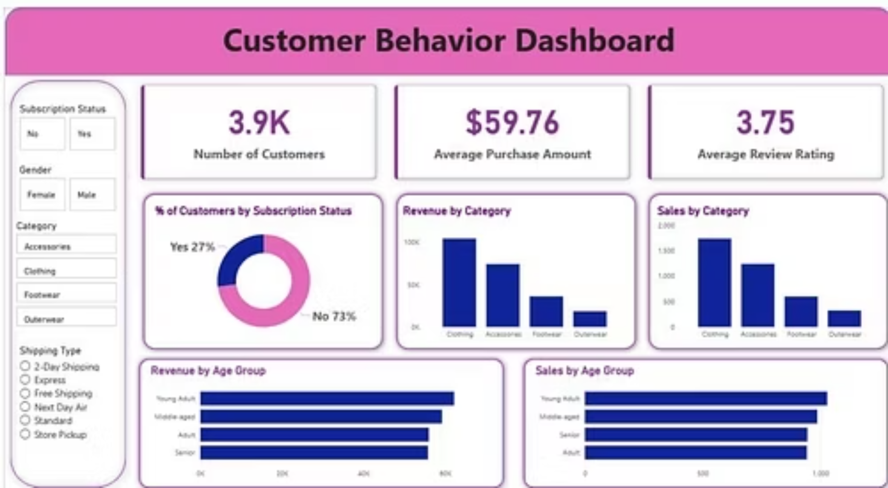
Detailed Dashboard View
Explore real-time customer data, drill down into performance metrics, and uncover actionable insights through our intuitive interface.

Slide 11



Strategic Recommendations
Boost Subscriptions
Loyalty Programs
Target 958 repeat buyers without subscriptions with exclusive benefits
Reward repeat buyers to accelerate movement into Loyal segment
Discount Strategy
Review discount policy - 839 high spenders used discounts, balance margin control
Product Positioning
Feature top-rated items in campaigns
Targeted Marketing
Focus on Young Adults and express shipping users

